Slide 1



SSG104
NOV 2022
HUONG NOI
Chapter 14 & 15
CHAPTER 14 & 15
HUONG NOI

Slide 2
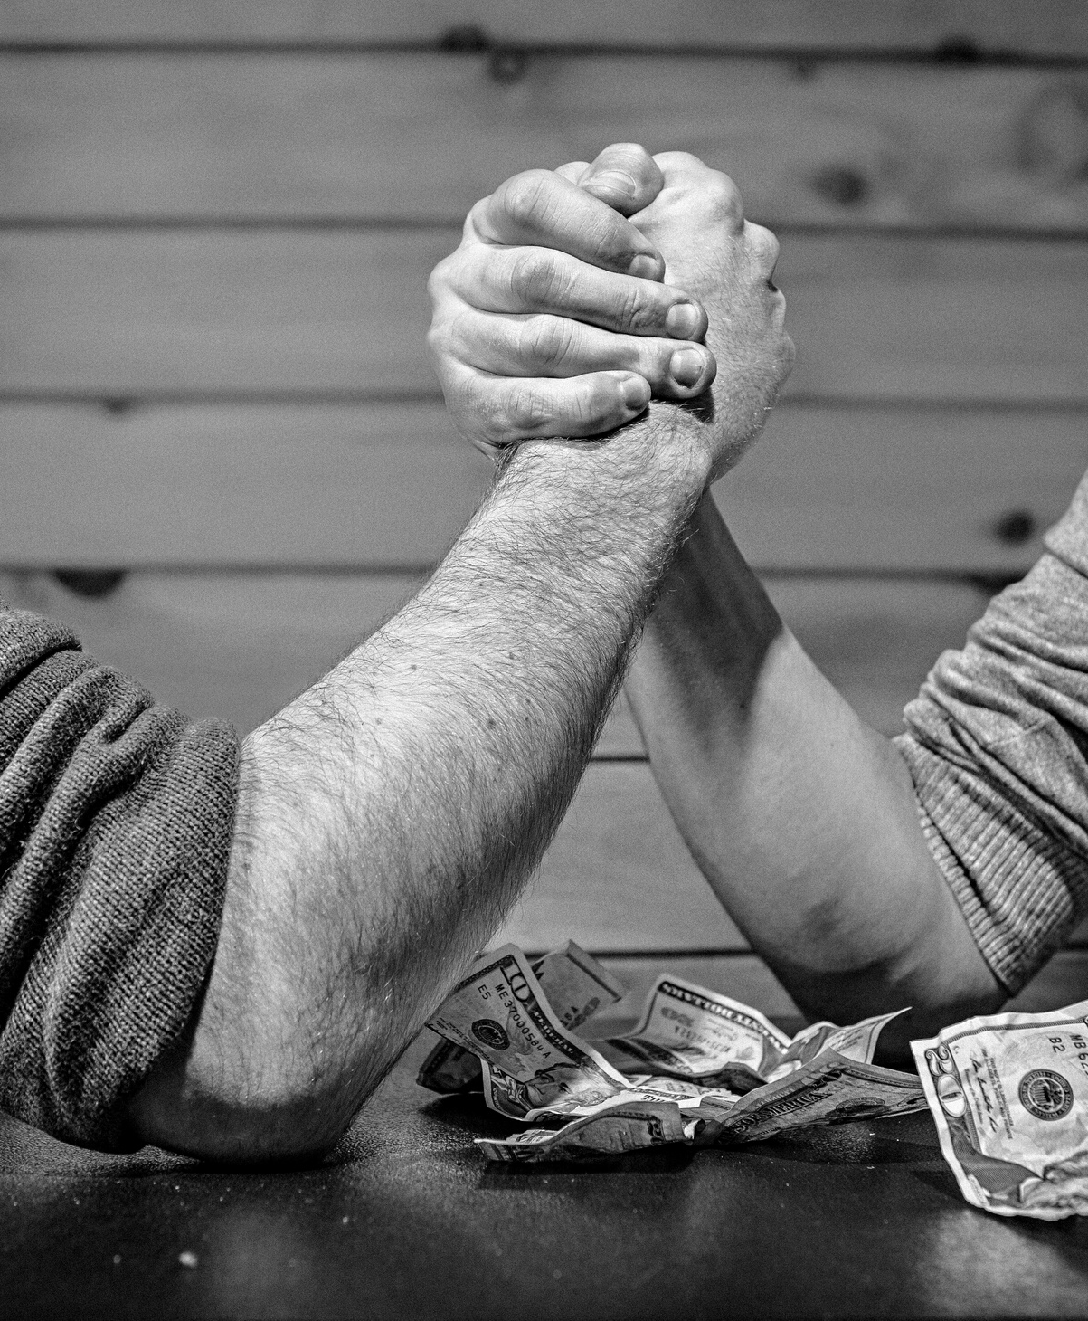
Table of content
HUONG NOI
  1. Conflict and negotiation
SSG104
2. Handling stress in a group

Slide 3


Conflict and negotiation
HUONG NOI

Slide 4
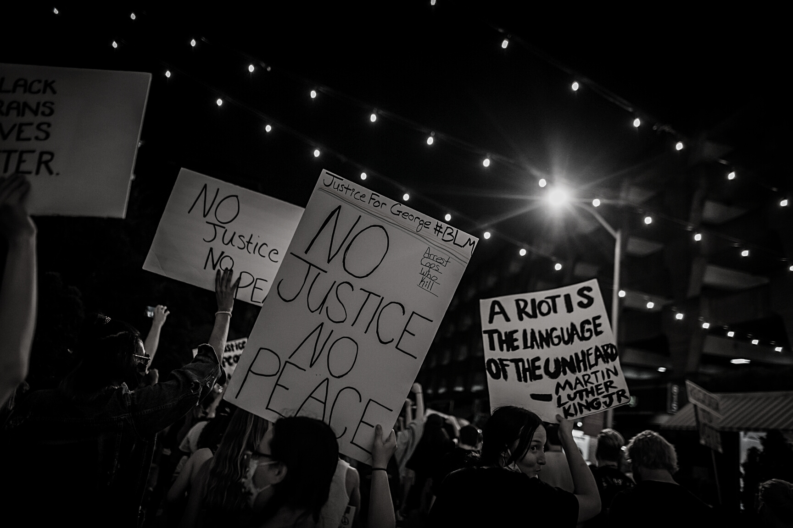
DEFINITION
The disagreement and disharmony that occurs in groups when differences are expressed regarding ideas, methods, and / or members.
Conflict has been defined by researchers Hocker and Wilmot as: “An expressed struggle between a least two interdependent parties who perceive incompatible goals, scare rewards and interference from the other party in achieving their goals.

Slide 5

DEFINITION
Negotiation - a process that occurs when two or more parties decide how to allocate scarce resources.

Slide 6


Group members express disagreement in a way that values everyone’s contribution and promotes the groups’ goal.
+ Respect others
+ Focus on issues
Constructive conflict
Group members scare hosstility and prevent achievement of the group ‘s goal.
+ Insult others
+ Inflexible and uncooperative
Destructive confflict

Slide 7



TASK
RELATIONSHIP
PROCESS

Slide 8


Conflict process
Stage I: Potential Opposition or Incompatibility
Stage II: Cognition and Personalization
Stage III: Intentions
Stage IV: Behavior
Stage V: Outcomes

Slide 9

NEGOTIATION process
  Preparation and planning
  Definition of ground rules
  Clarification and justification
  Bargaining and problem solving
  Closure and implementation

Slide 10
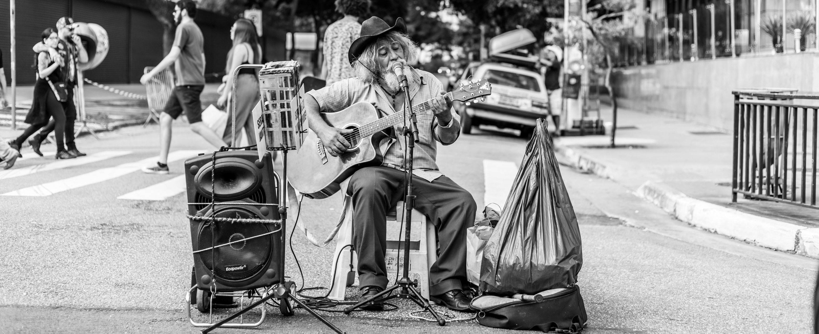
Individual Differences in Negotiation
  Personality Traits in Negotiations
  Moods/Emotions in Negotiations
  Culture in Negotiations
  Gender Differences in Negotiation
  Negotiating in a Social Context
  Reputation
  Relationships
  Third-Party Negotiations

Slide 11

Functional
Dysfunction

Slide 12
  Emphasizing group goals and effectiveness.
  Providing stable, well-structured tasks.
  Facilitating dialogue.
  Avoiding win-lose situations.
PREVENTING

Slide 13


Handling stress in a group
HUONG NOI

Slide 14

HOW TO hANDLING
Stress
IN GROUP
  Maintain Transparency.
  Be Respectful and Friendly.
  Encourage Everyone to Get Sufficient Sleep.
  Have Realistic Expectations.
  Encourage Two-Way Communications.
  Don’t Impose Severe Consequences for Failure.

Slide 15

SSG104
THANK YOU
HUONG NOI

